Slide 1
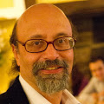
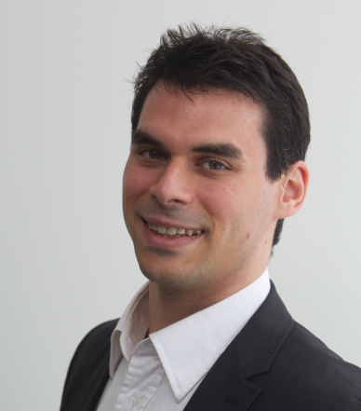
#ICPE2016
Alberto Avritzer
Sonatype Inc. USA
Alexandru Iosup
Delft University of Technology The Netherlands
@AIosup

Slide 2
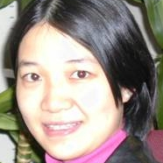
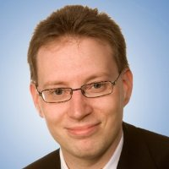
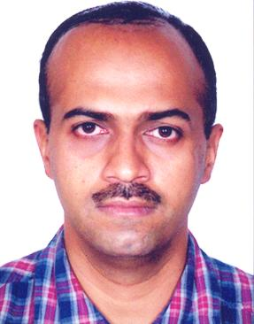
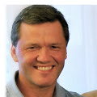
Authors List Organizing Committee [2/3]
Research Track
Industry Track
Xiaoyun Zhu
FutureWei Tech. USA
Steffen Becker
TU Chemnitz Germany
Manoj Nambiar
Tata TCS India
Jerome Rolia
Hewlett Packard Labs USA

Slide 3
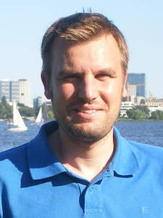
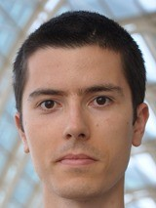
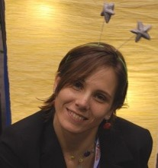
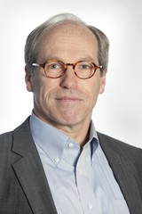
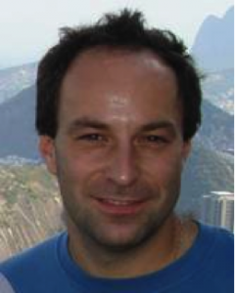
Organizing Committee [3/3] Authors List
Publicity Chairs
Daniel Sadoc Menasche
Dorina Petriu
Vanish Talwar
Alexander Wert
Timothy Wood
Yu Hua
Publication Chair
Catia Trubiani
Finance Chair
Anne Koziolek
Web Chair
Tim Hegeman
Special thanks
Marie Louise Verhagen
Els Bakker
ICPE SC and esp. Samuel Kounev Jose Nelson Amaral
Tutorial Chair
Workshop Chairs
Andre van Hoorn
U Stuttgart Germany
Mihai Capotă
Intel Labs USA
Ana Lucia Varbanescu
U. of Amsterdam The Netherlands
Doctoral Symposium Chair
Demos/Posters Chair
Dick Epema
TU Delft The Netherlands
Radu Prodan
U Innsbruck Austria

Slide 4
Acknowledgments Main Sponsors

Slide 5
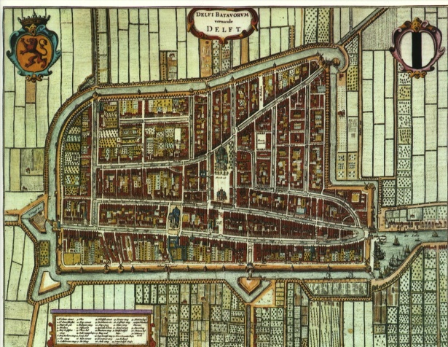
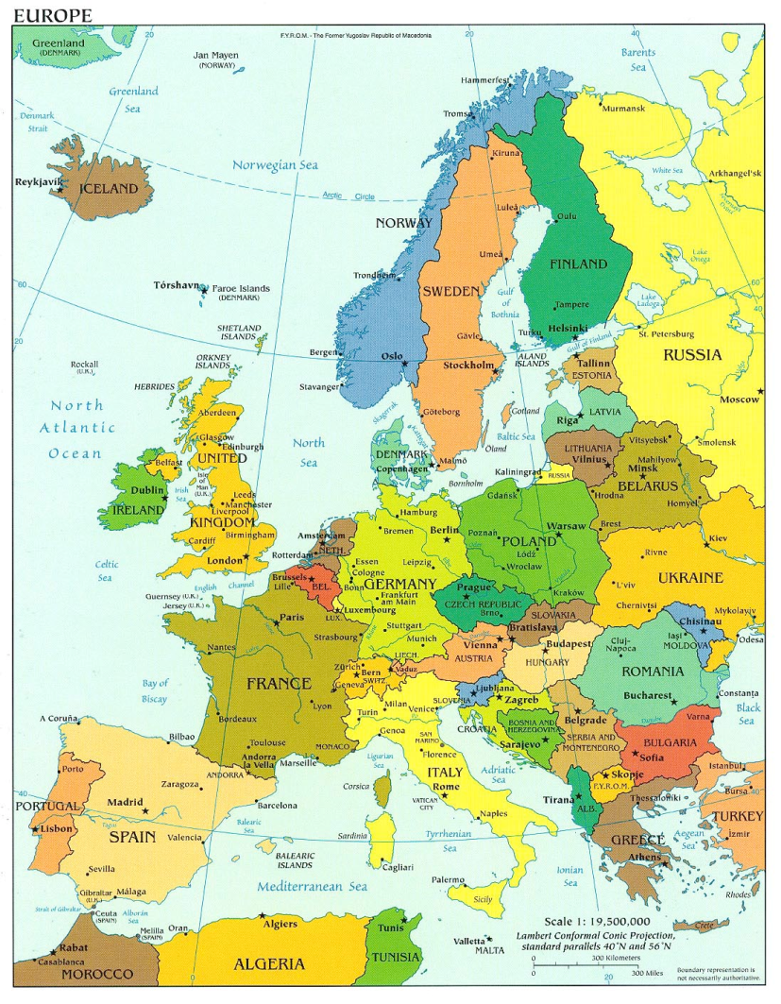
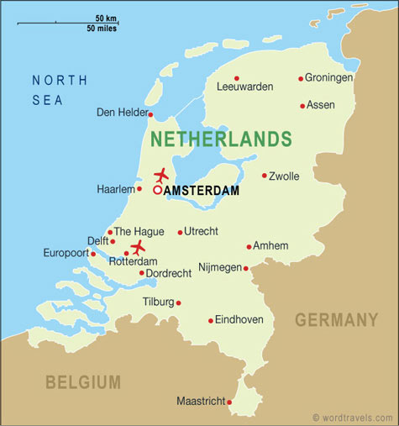
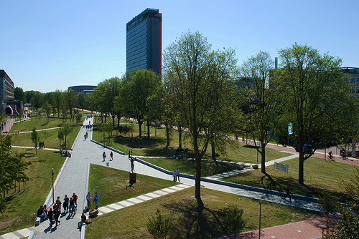
Experimental Setup (TU) Delft – Netherlands – Europe
founded 13th century
pop: 100,000
Delft in the Netherlands
founded 1842
pop: 20,000
The Netherlands in Europe
pop: 18 M
pop: 500 M

Slide 6
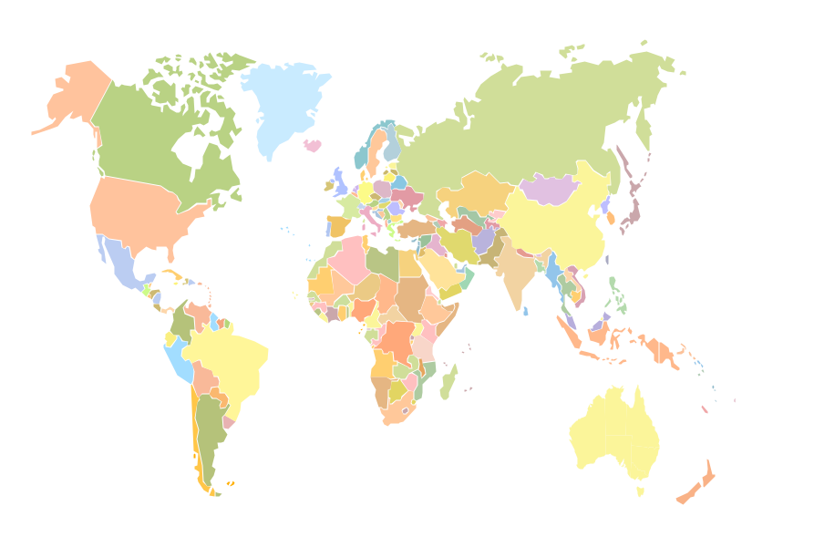
Experimental Results #ICPE2016 Statistics: Participants
18
1
12
5
3
1
4
2
20
4
1
1
6
3
8
2
2
1
Notes:
http://www.freeflagicons.com/country/italy/glossy_square_icon/

Slide 7
Experimental Results #ICPE2016 Statistics: Research Track
Submissions | 57
Accepted | 19
Acceptance rate | 33%

Slide 8
Experimental Results #ICPE2016 Statistics: WIP/Vision Track
Submissions | 16
Accepted | 6
Acceptance rate | 37.5%

Slide 9
Experimental Results #ICPE2016 Statistics: Industry Track
Submissions | 14
Accepted | 7
Acceptance rate | 50%
Authors Countries

Slide 10
Discussion Best Paper Candidates
Maximum Likelihood Estimation of Closed Queueing Network Demands from Queue Length Data.
Weikun Wang, Giuliano Casale, Ajay Kattepur, and Manoj Nambiar
Performance Modeling of Maximal Sharing.
Michael Steindorfer and Jurgen Vinju
Optimized eeeBond: Energy Efficiency with non-Proportional Router Network Interfaces.
Niklas Carlsson
Mon, 10am-10:30am
Tue, 10am-10:30am
Tue, 4pm-4:30pm

Slide 11
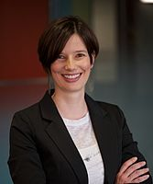
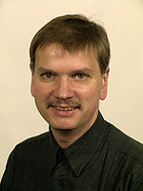
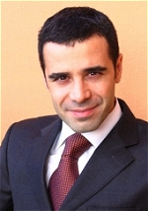
Discussion Keynotes
Every Day, 9am-10am
Bianca Schroeder
Wilhelm Hasselbring
Angelo Corsaro
U. of Toronto Canada
Case studies from the real world
Kiel University Germany
Microservices for Scalability
PrismTech United Kingdom
Cloudy, Foggy and Misty Internet of Things

Slide 12
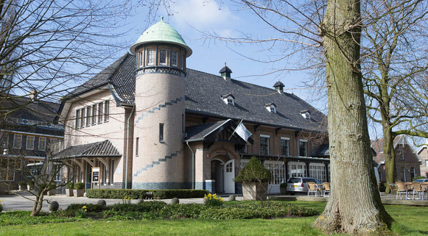
Appendix Practical Information
Need help? Registration desk or icpe2016-mc@tudelft.nl
Temporary proceedings online
Social dinner: De Lindenhof, Zochterweg 9, 2613ZT Delft To get there, pick one of:
Go there yourself: https://goo.gl/maps/BbJCvP46tE72
+ Tour of Delft center before?
Walk with us:
Tue, 7:30pm—10pm
Opt-in
Grote Markt, 7pm

Slide 14
Bianca Schroeder (U. Toronto) Keynote: Case studies from the real world: The importance of measurement and analysis in building better systems
Talk highlights
Big Data revolution supported by frameworks and systems
Big Data processing generates Admin Big Data from monitoring and logging
Analyzing Admin Big Data to understand performance and availability
Bio
Associate Professor + Canada Research Chair, U. of Toronto
Former Carnegie Mellon University, Mor Harchol-Balter, Garth Gibson
Outstanding Young Canadian Comp.Sci. Prize, Alfred P. Sloan Res. Fellow

Slide 16
Disclaimer: images used in this presentation obtained via Google Images.
Images used in this lecture courtesy to many anonymous contributors to Google Images, and to Google Image Search.
Many thanks!

